Slide 1


CMake – a magic tool for build management
Alex Kushnir
Biosense Webster

Slide 2
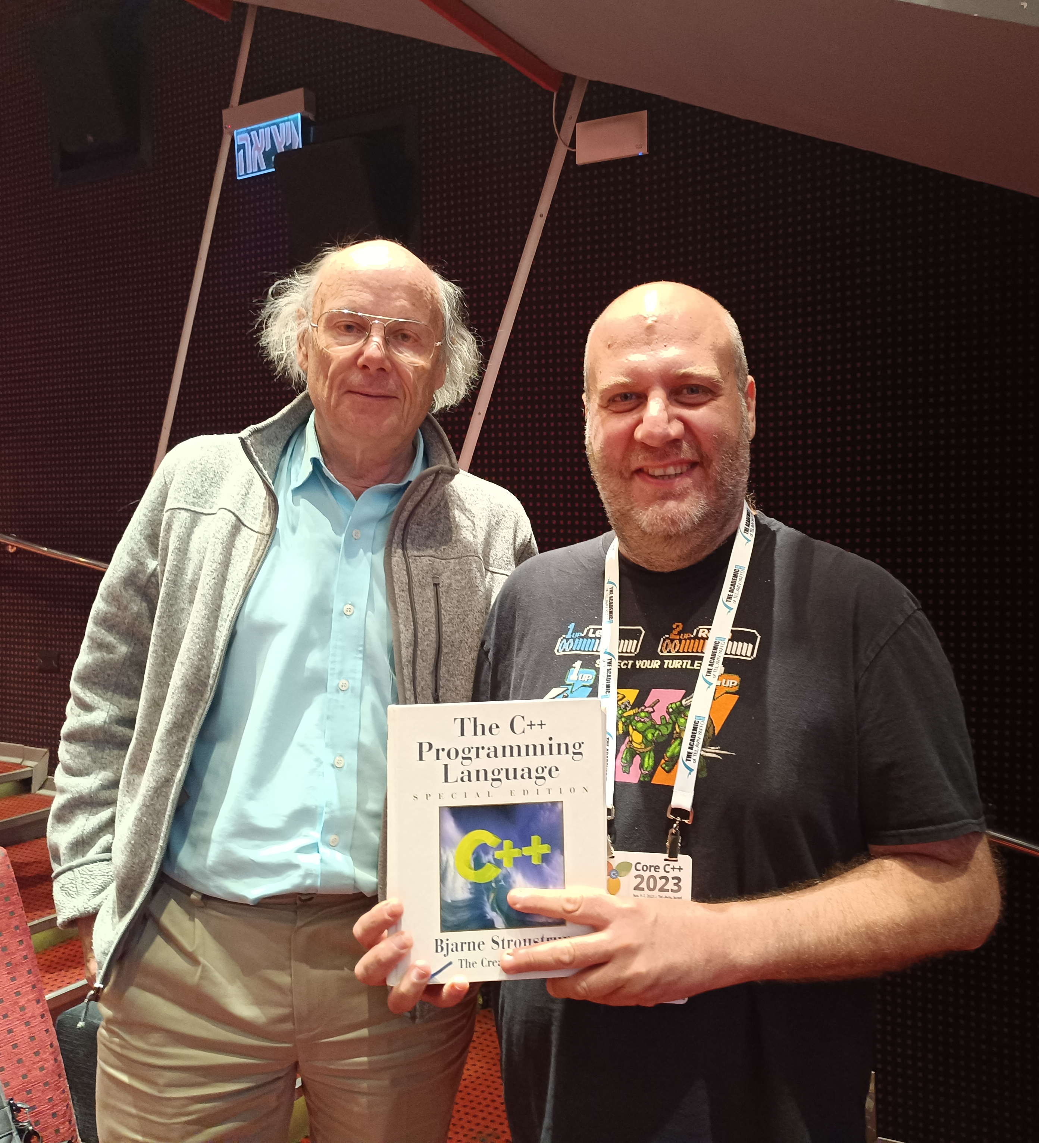
About me
Software engineer since 2007
Mostly embedded and low-level
Embedded Linux
C++
Methodologies and tools
Heavy metal \m/

Slide 3
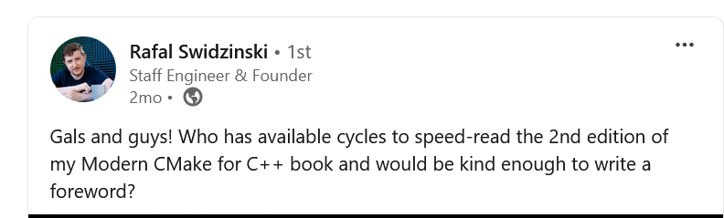
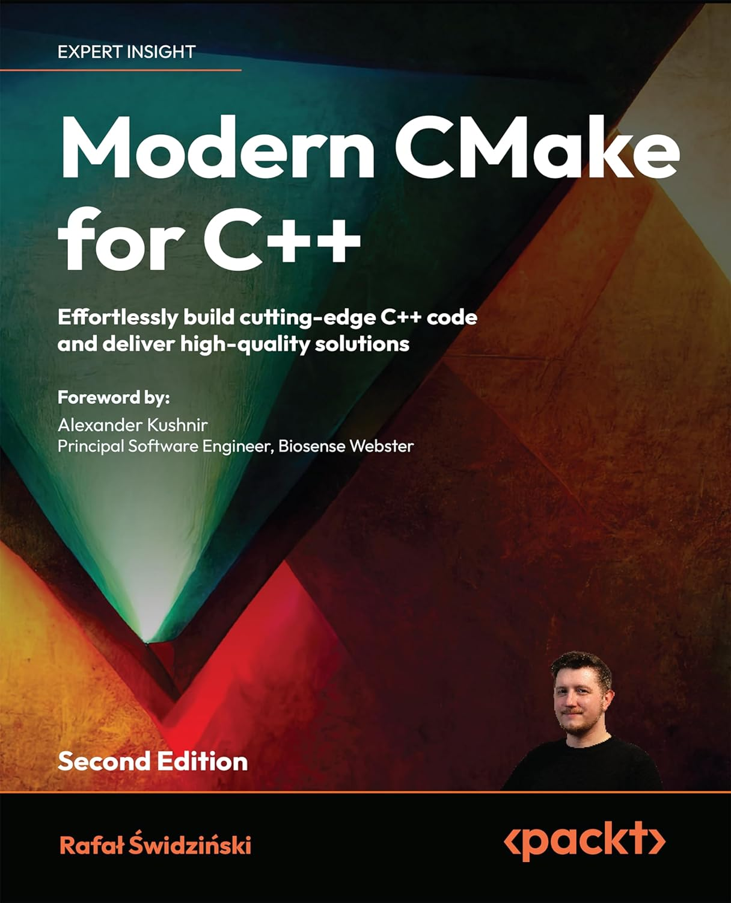
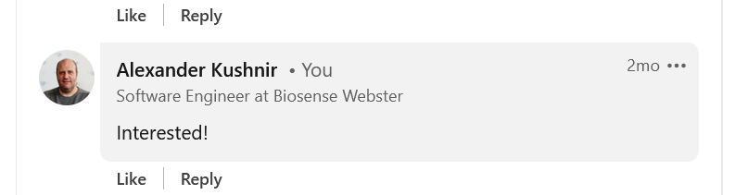
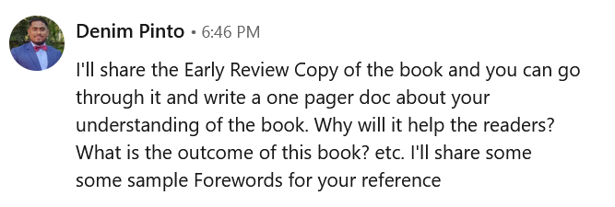
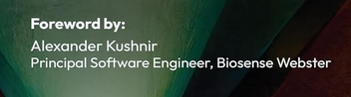
Modern CMake for C++
Click to purchase

Slide 4


About Biosense Webster
A global leader in treating complex arrhythmias
Part of the Johnson and Johnson MedTech
Large software group of professionals
Stack – C++/C#, Windows
Scan the QR to e-mail me

Slide 5
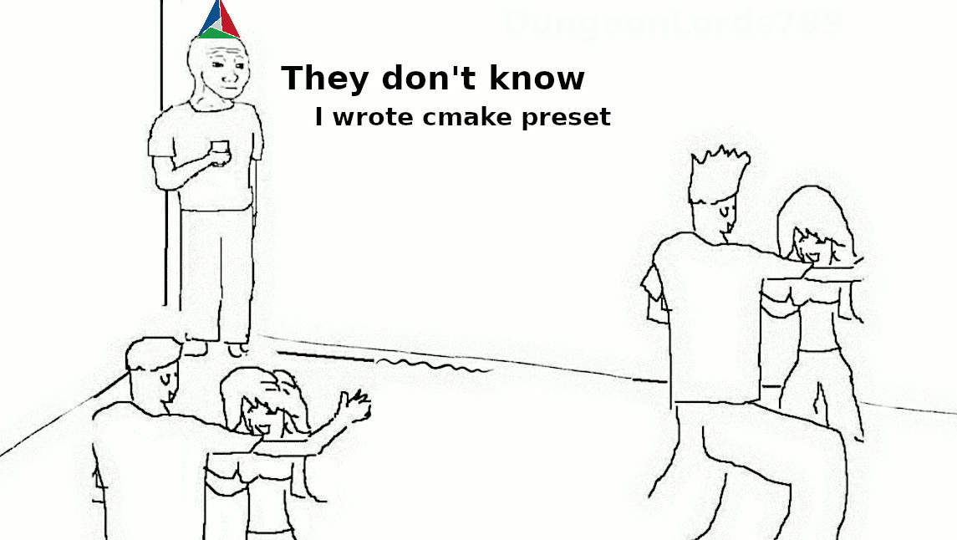

Slide 6
TABLE OF CONTENTS.
01
02
03
04
05
06
CMake in a nutshell
CMake basics
Working with C++20 modules
Further reading
Summary
Credits

Slide 7
CMake in a nutshell
01
<p> An open-source(BSD-3-Clause), cross-platform family of tools designed to build, test and package software </p>

Slide 8
Why build system?
Automation of build process – simplifies and ensures consistent builds
Dependencies management – handles file and 3rd party dependencies
Build multi-configurations – supports multiple configurations and cross-platform
Incremental builds – recompiles only changed files
Integrates testing and CI – automates testing and deployment
Customization – Allows custom build rules and integration with other tools
Isolated environment – Manages and recreates build environments easily

Slide 9
So…why CMake?
Focused on supporting modern compilers and toolchains
Truly cross-platform
Generates project files for all popular IDEs and CLI tools, and a project model for Clion
Tons of projects built with CMake
Testing, packaging and installing are an inherent part of the build process
Old features get deprecated

Slide 10
Key features
<p> Separate build tree </p>
Ability to place compiler outputs into a build tree which is located outside of the source tree
Enables multiple builds from the same source and multi-platform compilation
<p> Dependency management</p>
Keeps track and recompiles all dependencies of a given sub-module if its sources were changed
<p> One-stop shop </p>
Ability to build, test, package and install – all in one package

Slide 11
Several alternatives
<p> Bazel </p>
+ Fast, scalable, multilanguage support
- Learning curve, configuration complexity, limited IDE support
<p> Meson </p>
+ Ease of use, fast, developer friendly
- Less mature, limited IDE support, limited language support
<p> Autotools </p>
Come on…really?

Slide 12
CMake basics
02
<p> Let’s dive in </p>

Slide 13
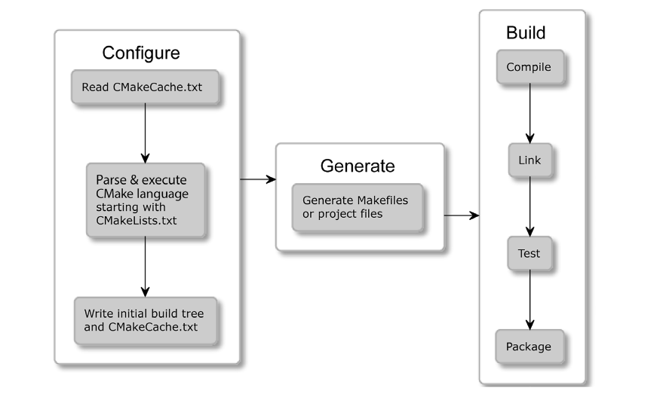
The build process stages

Slide 14
CMake generators
<p> What is generator? </p>
A tool that CMake uses to generate build files for various build systems
<p> What is supported? </p>
All common tools – VS, GNU Make, Ninja, etc.
Several IDEs use CMake as their primary build system (CLion)
<p> How to use? </p>
Command line –G flag → cmake –GNinja –S <source_dir> -B <build_dir>
For list of all supported generators → cmake --help

Slide 15
CMake build types
<p> What build types are supported? </p>
Debug, Release, RelWithDebInfo, MinSizeRel
<p> How to set the build type? </p>
cmake –DCMAKE_BUILD_TYPE=Debug –S <source_tree> -B <build_tree>
In CMakeLists.txt – set(CMAKE_BUILD_TYPE Debug CACHE STRING “Build Type” FORCE)
<p> What is the difference? </p>
Build types differ in debug information embedded and in optimization level

Slide 16
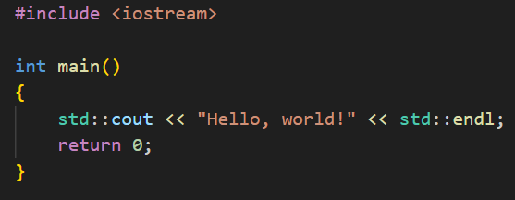
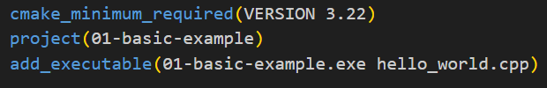



Let’s see some CODE!
hello_world.cpp
CMakeLists.txt
A part of an extremely complex project I’ve been working on recently
Notes:
01-basic-example after the slide

Slide 17
Consuming 3rd party packages
Suppose we have a need for boost::bimap
Suppose boost library is already installed on the filesystem
CMake has the solution – find_package()
The find_package() sets several variables that we would need
In case of boost
Boost_FOUND – Indicates whether find_package() succeeded
Boost_INCLUDE_DIRS/Boost_LIBRARY_DIRS –include/library directories
Several more variables

Slide 18
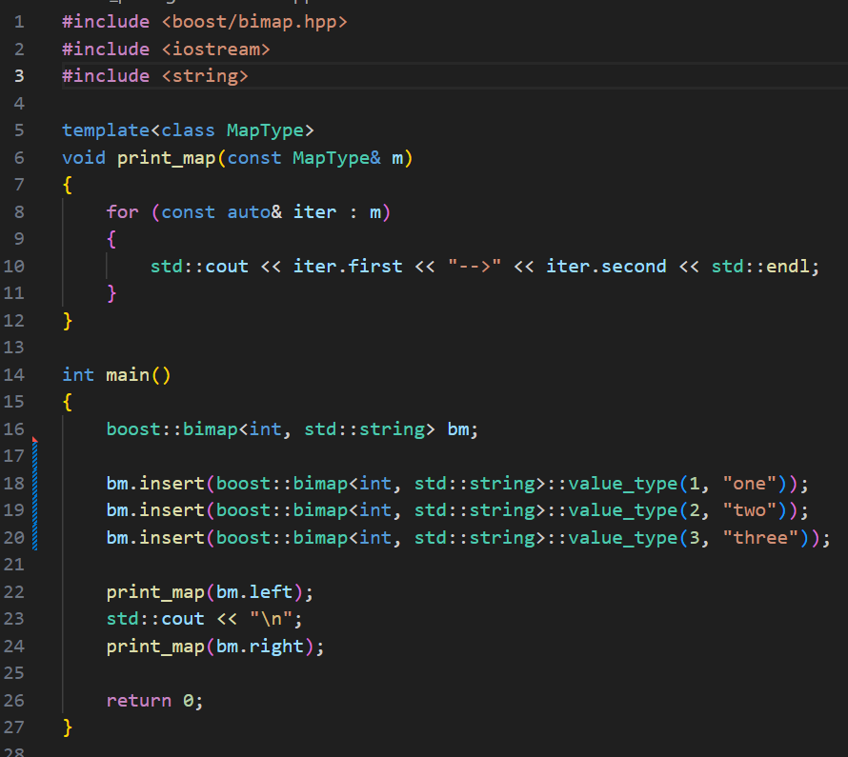
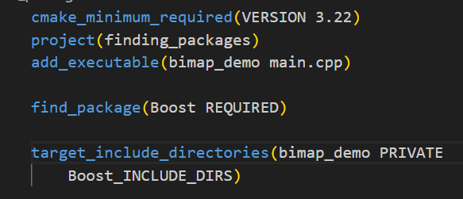
Let’s see some CODE!
Create boost::bimap and print it
Notes:
01-basic-example after the slide

Slide 19
Consuming 3rd party code
Not all packages provide interface for find_package()
Sometimes it is preferred to download the source code directly
The FetchContent module can help
Advantages
No external package manager needed
Controlled versions
Integrated build

Slide 20
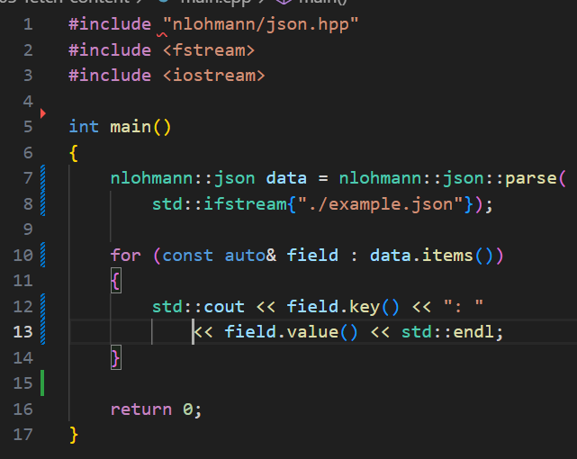
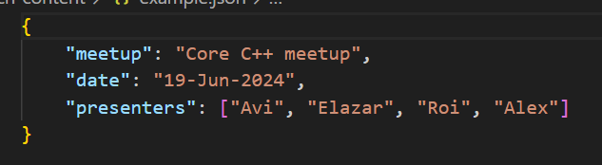
Let’s see some CODE!
A small code snippet that parses a given JSON and prints it
Notes:
01-basic-example after the slide

Slide 21
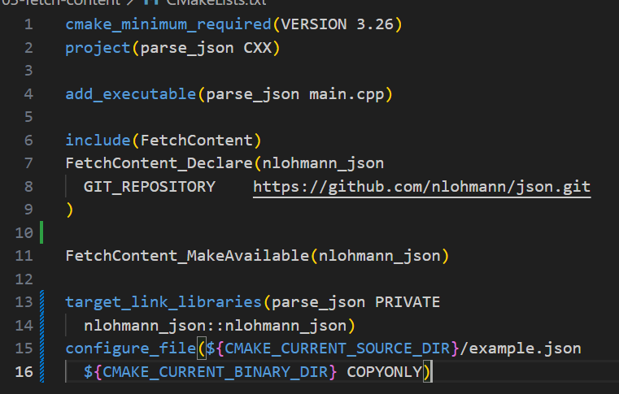
Let’s see some CMakeLists!
Notes:
01-basic-example after the slide

Slide 22
Working with C++20 modules
03
<p> CMake now supports one of the most powerful C++20 features! </p>

Slide 23
Using C++20 modules
Required – CMake 3.28, Visual Studio 2022 v17.4 (tested with 17.10)
Recap about C++ modules
The BMI (Binary Module Interface) – like a header file, in binary format
The Module Implementation Unit – provides the implementation, definitions and internal details
Were introduced to reduce compilation time and address problematic aspects of the preprocessor
Notes:
The most important setting is the LANGUAGES

Slide 24
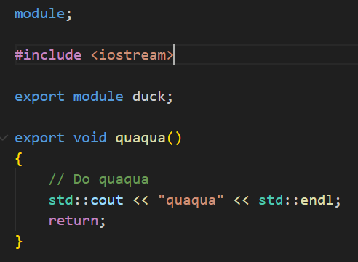
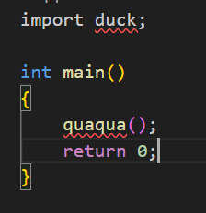
Let’s see some CODE!
A part of another top-secret project that makes computer sound like an animal!
Notes:
01-basic-example after the slide

Slide 25
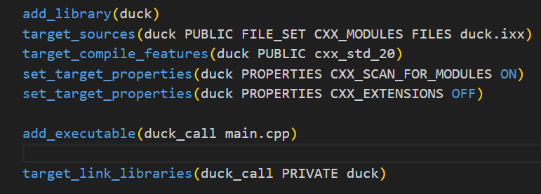
Let’s see some CMakeLists!
Instructs the compiler to treat the file as C++20 module
Ensures the library can be used in other projects
Notes:
01-basic-example after the slide

Slide 26
Further reading
04
<p> What else? </p>

Slide 27
What else?
Books
Mastering CMake – from the official CMake website
Modern CMake for C++ - ☺
Videos
CppCon 2017: Mathieu Ropert “Using Modern CMake Patterns to Enforce a Good Modular Design”
Modern CMake Modules - Bret Brown - CppCon 2021
Notes:
The most important setting is the LANGUAGES

Slide 28
Summary
05

Slide 29
Summary
CMake - a powerful tool for building, testing and shipping software
Tons of capabilities
Keeps up with the latest innovations and standards
Try it yourself!
Notes:
The most important setting is the LANGUAGES

Slide 30

Slides and code
https://github.com/alexkushnir/corecpp_cmake_talk
Notes:
The most important setting is the LANGUAGES

Slide 31
Credits
06

Slide 32
CREDITS.
Presentation Template: SlidesMania
Sample Images: Unsplash
Fonts used in this presentation: Roboto Mono and Roboto Bold

Slide 33
THANK YOU!
Drop me an e-mail
Connect with me on LinkedIn
Do you have any questions?

